Slide 1
NASA Web World Wind - KML
GSKY client derived from NASA World Wind using KML.
Third party data from OpenStreetMap are overlaid on GSKY
ACKNOWLEDGEMENT
This document describes a software that has been derived from an SDK provided by NASA. The SDK is licenced as per the Apache licence and is therefore it is free to modify, use and distribute. However, the source code of the final product is the property of NCI and must not be given out, as it uses a Bing Maps licence key that is not transferable.
Copyright © 2019 by National Computational Infrastructure, Canberra, ACT, Australia.
Author: Dr. Arapaut V. Sivaprasad.
19 June, 2019

Slide 2
INTRODUCTION
Slides 2-5 are for developers. Slide 6-7 are user guide.
Web WorldWind is a free, open-source virtual globe for web pages. Written in JavaScript, Web WorldWind enables web page and application builders to quickly create interactive visualizations of geographic information on an interactive 3D globe or 2D map. Web WorldWind provides an API that enables JavaScript programs to control every detail of visualization and interaction. Web WorldWind runs on all major operating systems, desktop and mobile devices, and web browsers.[^{Ref}]
Download
All source code is open source for developers throughout the world. Fork the repository on GitHub!
Software Architecture
The software is composed of a HTML front-end page and several JavaScript files. These JS files control every aspect of the operation and are portable to any machine running a web server. There are external calls to NASA’s (and others’) servers to get the images, maps and layers that go into the display. These cannot be altered without breaking the program.
Integration with GSKY
The integration is a combination of dynamic WMS plus static KML. The GSKY layers are fetched via static WMS calls like below.
http://130.56.242.15/ows/ge?SERVICE=WMS&amp;VERSION=1.1.1&amp;REQUEST=GetMap&amp;SRS=EPSG:4326&amp;WIDTH=512&amp;HEIGHT=512&amp;LAYERS=global:c6:monthly_decile_total_cover&amp;STYLES=default&amp;TRANSPARENT=TRUE&amp;FORMAT=image/png&amp;BBOX=-55.6,-3.1,-53.5,-1.0&amp;TIME=2001-01-01T00:00:00.000Z
Static overlays on the GSKY data are created as KML code (given in slide x).
Typically, the published URL will be similar to the one below.
http://130.56.242.19/NASA/WorldWind/geoglam_wrapper_kml.html
Next: Technical Details

Slide 3
Technical Details
The system is composed of three parts…
Front-end web wrapper for input and output
iFrame source calling the main JavaScript
Main JavaScript calling the KML file
DETAILS:
Web Wrapper: GskyNWW*
Typical HTML web page with text and input boxes with two iFrames and a web form.
iFrame to display the World Wind engine
<iframe id="NWW" style="width:100%; height:710px"></iframe>
iFrame to display the Bounding Box Finder
<iframe id="BBox_finder" style="width:100%; height:600px"></iframe>
HTML Form to input the details
iFrame source: nww_kml.html*
<script data-main=“nww_kml"# src="https://cdnjs.cloudflare.com/ajax/libs/require.js/2.1.17/require.min.js"></script>
Main JS: nww_kml.js*
Data file: nww.kml*
var kmlFilePromise = new WorldWind.KmlFile('data/nww/nww.kml’**, [new WorldWind.KmlTreeVisibility('treeControls', wwd)]);
iFrame source: BBox
* Click the links and view the page sources for details
# It is where the main JS file is specified. A *.js file must be present in that location. This file is static and needs not be edited at all.
** This file is dynamically created by a Perl CGI which is the backend of the web wrapper. The directory must be writeable to ‘apache’.

Slide 4
Technical Details - Wrapper
Web Wrapper: GskyNWW*
Salient features and code are explained here. The rest are plain HTML.
The GEOGLAM layers are hard coded in this HTML page. Selecting one inserts its data acquisition dates hard coded in ‘nww_kml_ajax.js’.
Several geographic regions are hard coded. Selecting one inserts its bounding box coordinates hard coded in the above JS file.
The wrapper is both desktop and mobile friendly. When opened on mobile, it is redirected to a different version of the page.
Mobile detection
<script>
var url = document.location.href;
if(url.indexOf('index.html') >= 0) url = url.replace('index.html','m_geoglam_wrapper_kml.html');
else url = 'm_geoglam_wrapper_kml.html';
(function(a,b){if(/(android …||window.opera,url);
</script>
The 'm_geoglam_wrapper_kml.html’ is a mobile-specific page with fewer text and large buttons. It will be called when the page is opened on a mobile device or tablet.
World Wind View Pane
<div id="nww_section" style="display:none">
<iframe id="NWW" style="width:100%; height:710px"></iframe>
</div>
Clicking the ‘Display’ button will create a selection-specific KML file to show the layers on a map in World Wind. The HTML will be the source for the iFrame above.
Note: Currently the JS, KML and HTML files are named as ‘/nww_kml.js’, ‘data/nww/nww.kml’ and ‘/nww_kml.html’, respectively. It is required to name them dynamically so that two or more simultaneous users will not overwrite each other’s files. A session cookie to track the user and name these files will be implemented.

Slide 5
Technical Details - JavaScripts
AJAX and Navigation JS: nww_kml_ajax.js
This JS file contains the AJAX and other navigation functions.*
The following are hard coded within this JS file:
The data acquisition dates for the GEOGLAM layers.
Bounding box coordinates for the geographical regions that are hard coded in the HTML.
The key/value pairs for the overlays.
NASA World Wind JS: nww_kml.js
This file is a modified version of KML.js provided by NASA. It must reside in the same directory with the other JS files.
The following is the only change in this JS:
var kmlFilePromise = new WorldWind.KmlFile('data/nww/nww.kml', [new WorldWind.KmlTreeVisibility('treeControls', wwd)]);
* There are more functions than what are absolutely necessary. They must be cleaned out.

Slide 6
Technical Details - KML
Dynamic KML File: data/nww/nww.kml
This file is dynamically generated by a Perl CGI that runs via AJAX from the main wrapper page. Since the user, apache, runs the CGI, the directory and file, if any, must have write privilege to ‘apache’.
drwxrwxrwx. 2 avs900 z00 34 Jun 24 10:22 .
-rw-r--r--. 1 apache apache 504K Jun 24 11:38 nww.kml
<?xml version="1.0" encoding="UTF-8"?>
<kml xmlns="http://www.opengis.net/kml/2.2">
<Document>
<name>______Layers_______</name>
<GroundOverlay>
<name>Fractional Cover C6 </name>
<visibility>1</visibility>
<Icon>
<href> http://130.56.242.15/ows/ge?SERVICE=WMS&amp;VERSION=1.1.1&amp;REQUEST=GetMap&amp;SRS=EPSG:4326&amp;WIDTH=512&amp;HEIGHT=512&amp;LAYERS=global:c6:frac_cover&amp;STYLES=default&amp;TRANSPARENT=TRUE&amp;FORMAT=image/png&amp;BBOX=135.703125,-29.840644,138.339844,-26.745610&amp;
</href>
<viewRefreshMode>onStop</viewRefreshMode>
<viewBoundScale>0.75</viewBoundScale>
</Icon>
<LookAt>
<longitude>137.0214845</longitude>
<latitude>-28.293127</latitude>
<altitude>464255.1</altitude>
</LookAt>
<LatLonBox>
<north>-26.745610</north>
<south>-29.840644</south>
<east>138.339844</east>
<west>135.703125</west>
</LatLonBox>
</GroundOverlay>
<GroundOverlay>
…
</GroundOverlay>
Contd…
KML header lines
Caption for GSKY layers
WMS call to the GSKY server
Camera coordinates and elevation
Polygon coordinates for the GSKY layer
End of one GSKY layer

Slide 7
Technical Details - KML
Dynamic KML File: data/nww/nww.kml (Contd…)
<Folder>
<name>natural|water: 398</name>
<visibility>1</visibility>
<LookAt>
<longitude>137.0214845</longitude>
<latitude>-28.293127</latitude>
<altitude>464255.1</altitude>
</LookAt>
<Placemark>
<name> </name>
<visibility>1</visibility>
<Style><LineStyle><color>ff00ff00</color></LineStyle><PolyStyle><fill>1</fill></PolyStyle></Style>
<MultiGeometry><Polygon><outerBoundaryIs><LinearRing>
<coordinates>137.7264071,-28.1236032 137.7276088,-28.1267824 137.7301837,
...
137.6069573,-29.0204953 137.6098756,-29.022897</coordinates>
</LinearRing></innerBoundaryIs></Polygon></MultiGeometry>
</Placemark>
<Placemark>
...
</Placemark>
</Folder>
<Folder>
<name>______Placemarks__________</name>
</Folder>
</Document>
</kml>
Overlay item: key|value: # of polygons
Ground coordinates and camera elevation
Polygons representing overlay item
End of grouped item
Caption for component items

Slide 8
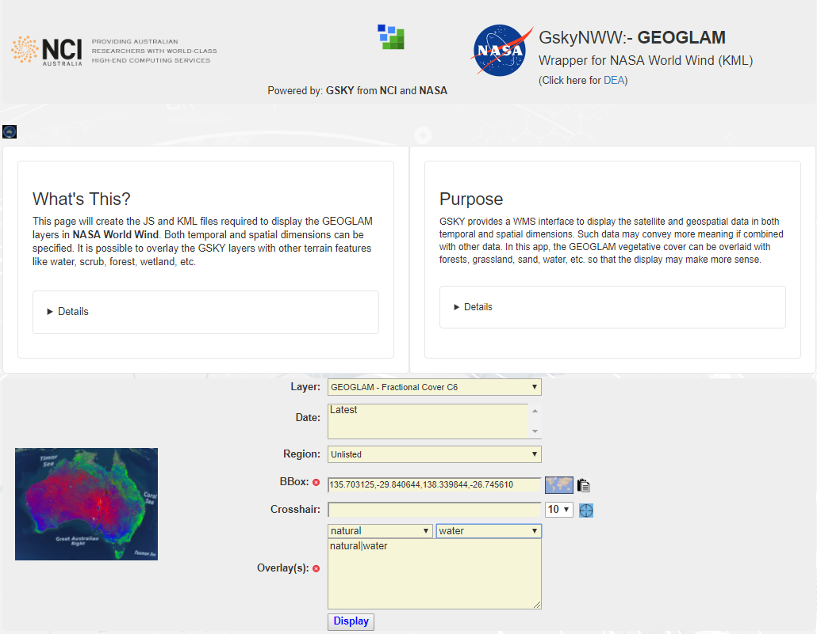
User Guide – Web Wrapper
This slide must be viewed as Slide Show
http://130.56.242.19/NASA/WorldWind/geoglam_wrapper_kml.html
Clicking this button will toggle the World Wind view pane where the globe is displayed.
A brief description about this web wrapper. Get more information by clicking ‘Details’ below.
The logic behind this web wrapper. The ‘Details’ below will show concise operation of the program.
Expanded description
How to operate
All available GEOGLAM layers are listed here, and one is selected by default. Selecting another will fill the ‘Date’ box with the data acquisition dates for that layer and change the thumbnail picture.
All available data acquisition dates for the selected GEOGLAM layer will be listed here. You can select more than one by Ctrl-click or Shift-click.
Several geographical regions are hard coded here for simplicity. Select one from the list or manually input the bounding box coordinates for any other region.
Thumbnail that will show how the selected layer will look over Australia. Clicking this image will toggle the World Wind view pane where the globe is displayed.
Locate a region by placing a crosshair on a map (see next slide). Click the crosshair icon to insert the BBox coordinates and fetch the data.
Select one or more overlay layers. Selecting the key (left) will list all its values (right) from which the selection(s) are made. Manually delete a line or delete all by clicking the cross button.
Click ‘Display’ to fetch the GEOGLAM layers plus the overlay layers, if any, and call the World Wind engine to display the globe. Depending on the area and the overlays it may take a few seconds to 2 minutes. Can cancel if taking too long. Will time out after 2 minutes.
Display a ‘Bbox Finder’ (see next slide) to define a region on a map. Clicking the paste button will insert the coordinates and fetch the data.

Slide 9
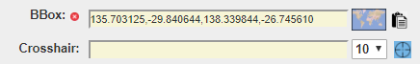
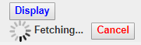
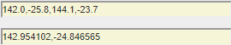
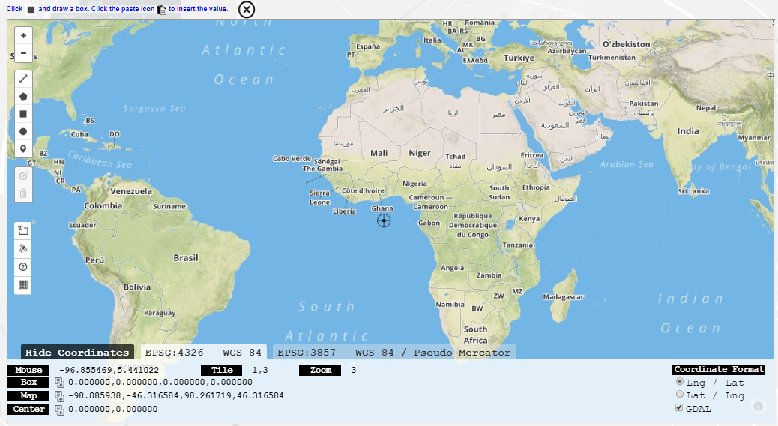
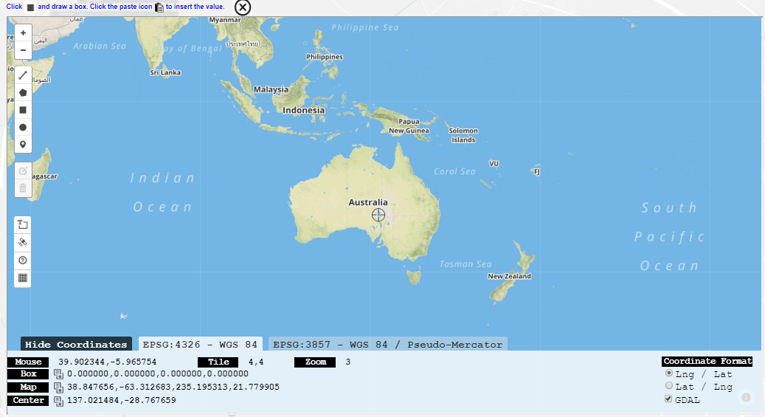
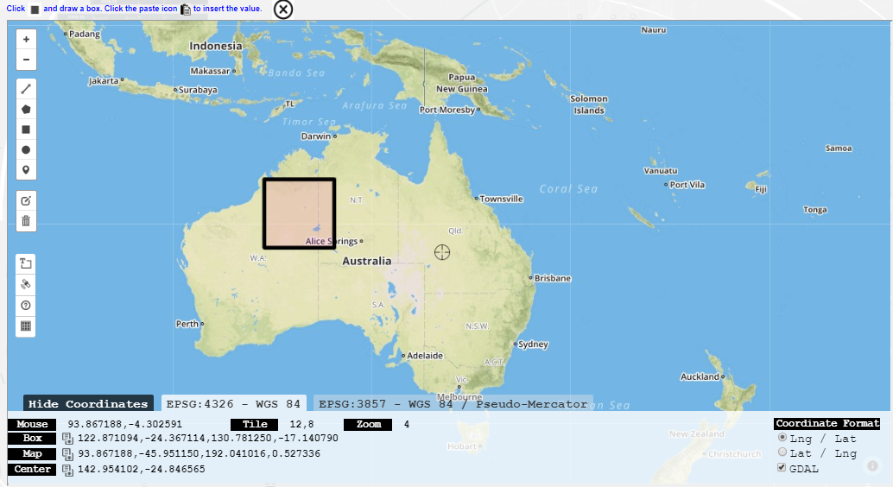
User Guide – BBox Finder
The BBox Finder is a separate program that is embedded into GskyNWW. It helps to get the minX, minY, maxX, maxY values of a box drawn on the map. This value will be fetched and inserted into the wrapper for creating the GSKY and/or overlay layers. The BBox Finder also lets you move a crosshair into position and display the GSKY layers around it.
Cancel if taking too long to fetch
A number from 1 to 25 in the dropdown defines the area around the crosshair. One unit is 1 tile of ~22 km². Therefore, 10 means 100 tiles (220km²) and 25 means 625 tiles (550 km²)
BBox Tool
BBox
Crosshair
Coordinates

Slide 10
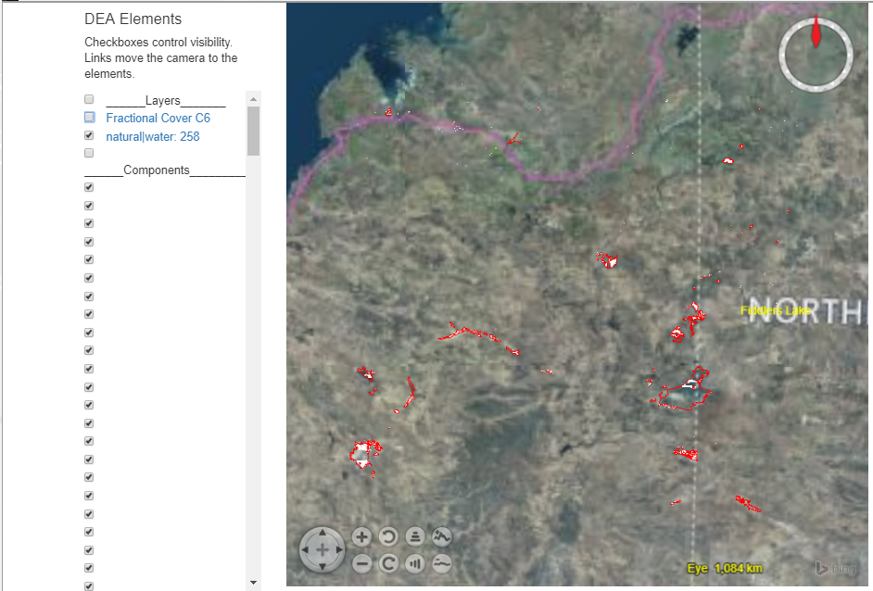
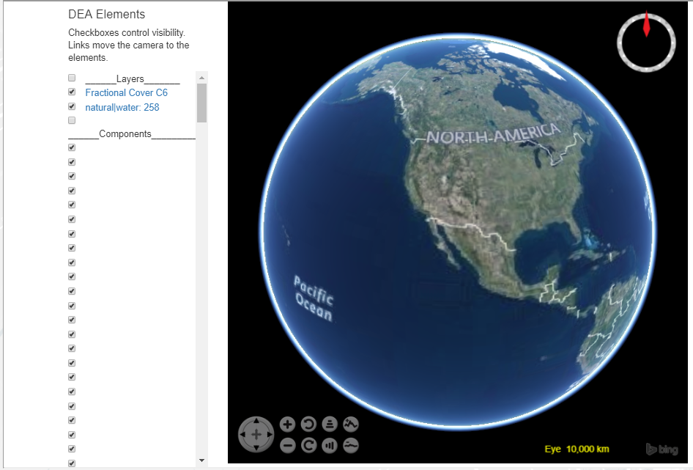
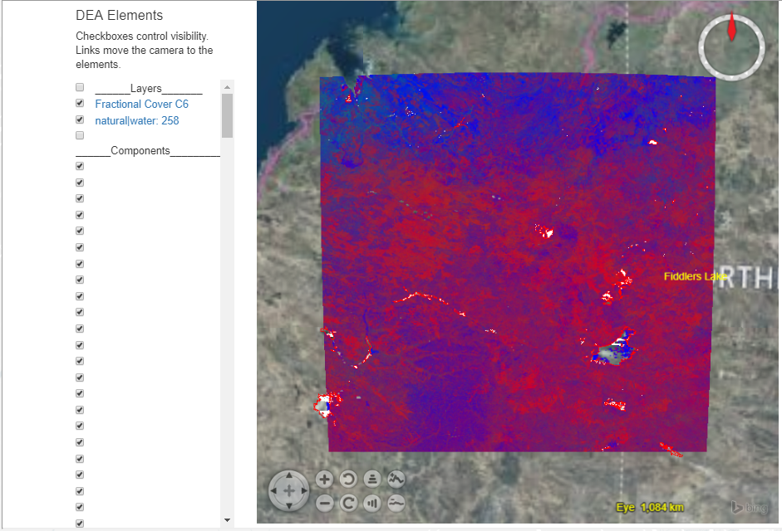
User Guide – World Wind Pane
The overlay layer(s) will be superimposed on the GSKY layer. Click the links to zoom to the area.
If multiple dates are selected, only the first in the list will be shown and the rest will not be visible initially. Check/uncheck the time layers to see how they differ.

Slide 11
TITLE

Slide 12






Acknowledgements

